Slide 1
Project title
Team Member | Role | Major Contribution(s)
雷艺湧Timmy | project manager | 1. Project plan and work assignment 2. Technical assessment and audit 3. Record the work of team members 4. Report
李展 | backend | 1. Material management 2.Warehouse monitoring (MQTT)3. Algorithm development （YOLO，HRRN）
李家兴 | backend | 1.Database design 2.Order management module 3.User module 4.Data dashboard module 5.Scheduling and forecasting algorithms
郭秋缘 | frontend | 1.Raw material management page 2.order management page 3.Device management page 4.order history page 5.Home and login page 6.software testing
刘锦程 | frontend | 1.interface design 2.user experience optimization,3.and data dashboard development.
胡杰 | hardware | 1. Design six nodes and transmission protocols2. Write node code3. Test multiple times to ensure program operation4. Assist in completing the entire project
王开森 | …… | ……

Slide 2
Project Overview
The main objective is to solve three main problems:
information is not synchronized
information processing is not timely
decision-making relies on experience rather than data

Slide 3
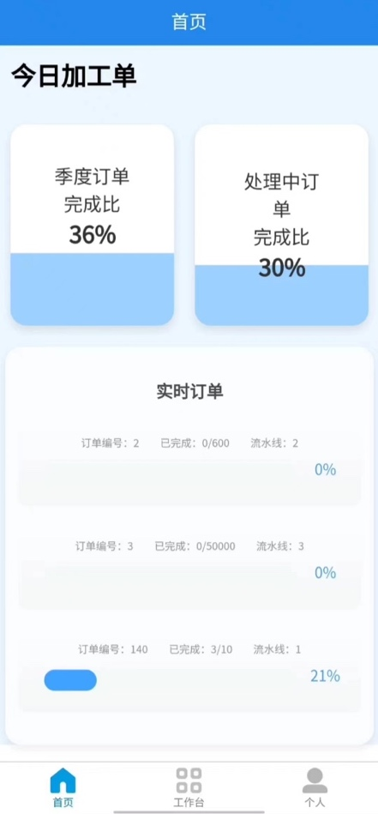
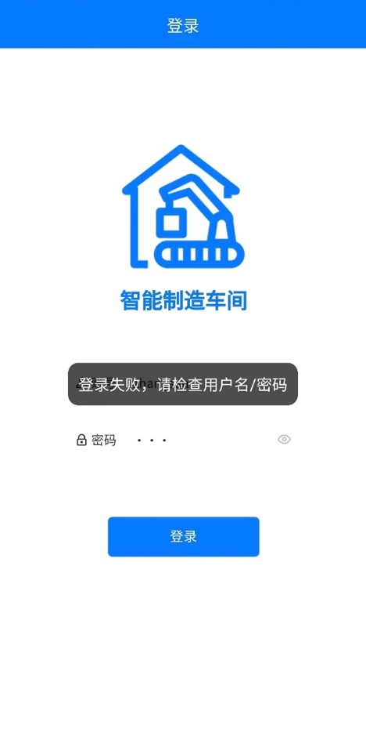
This is the login interface and home page of our system, which shows the basic work information of the workshop
人

Slide 4
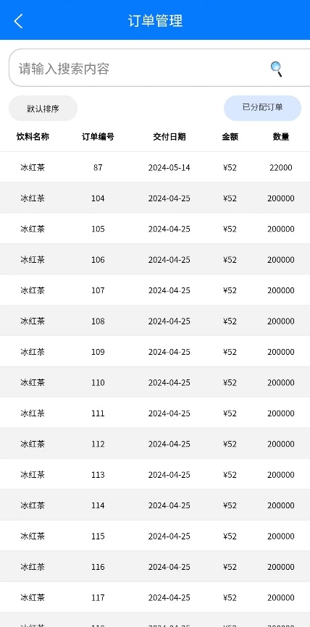
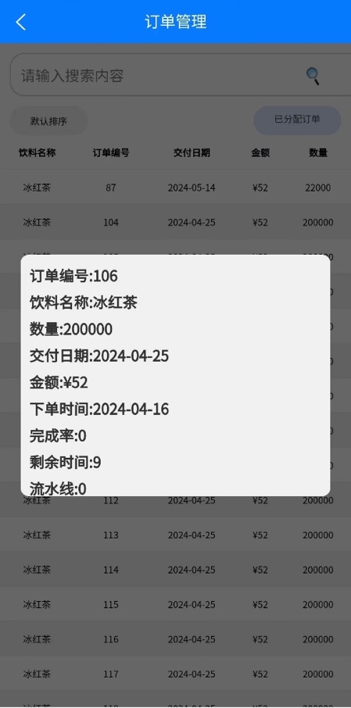
This is the order details page that tells you the details of your order

Slide 5
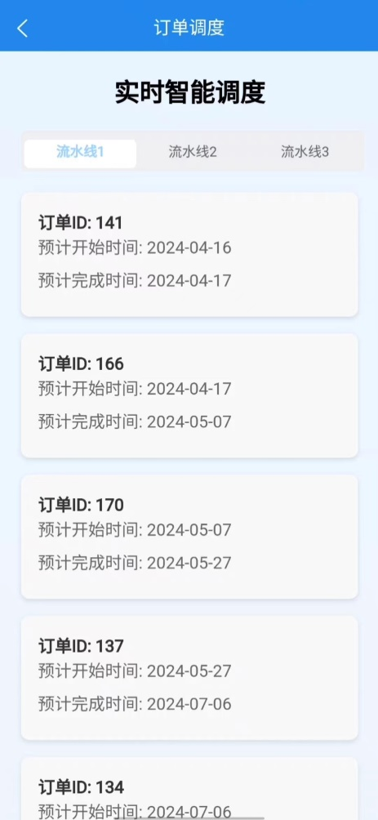
Our system can automatically arrange the order production sequence, so that all customers have the shortest waiting time

Slide 6
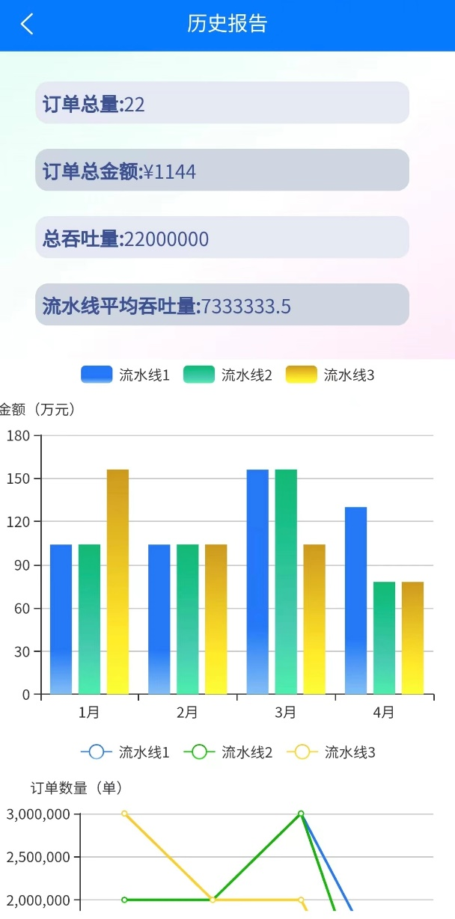
There is also a detailed summary and forecast here

Slide 7
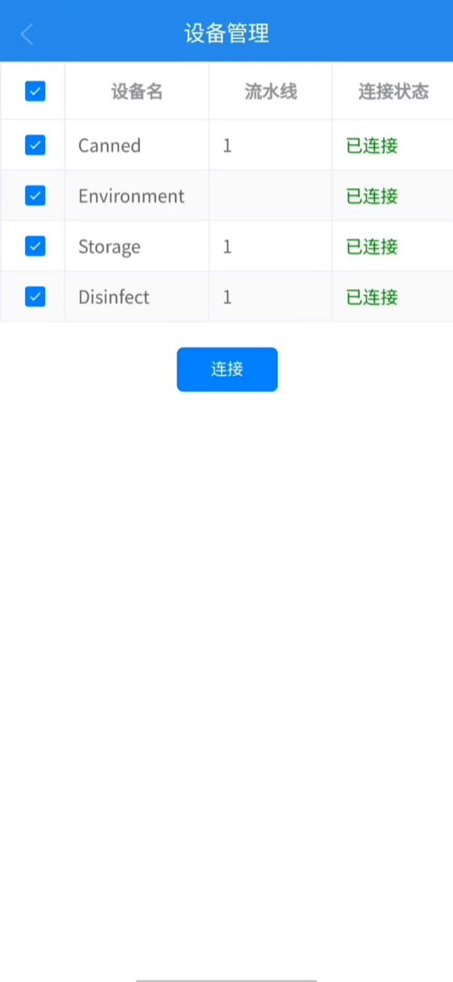
We have implemented adaptive connectivity, which can be connected as if it were wifi

Slide 8
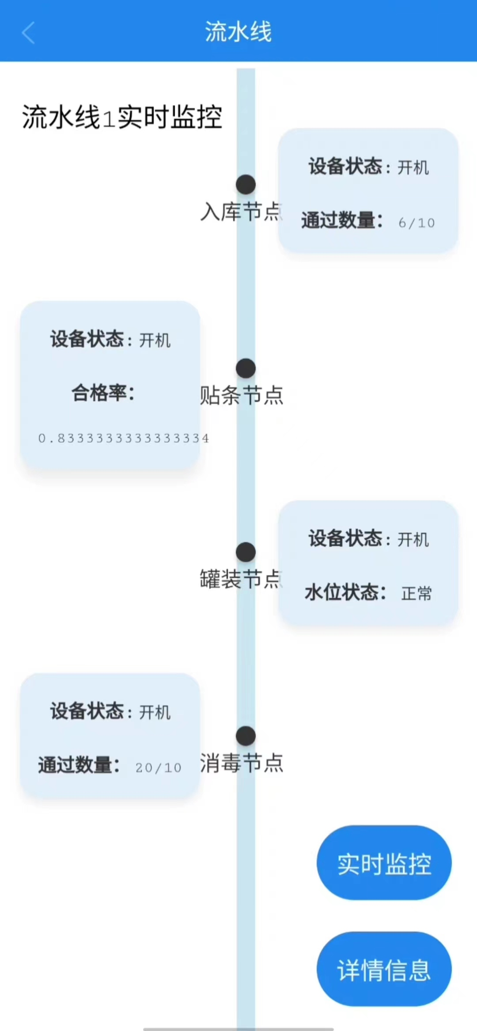
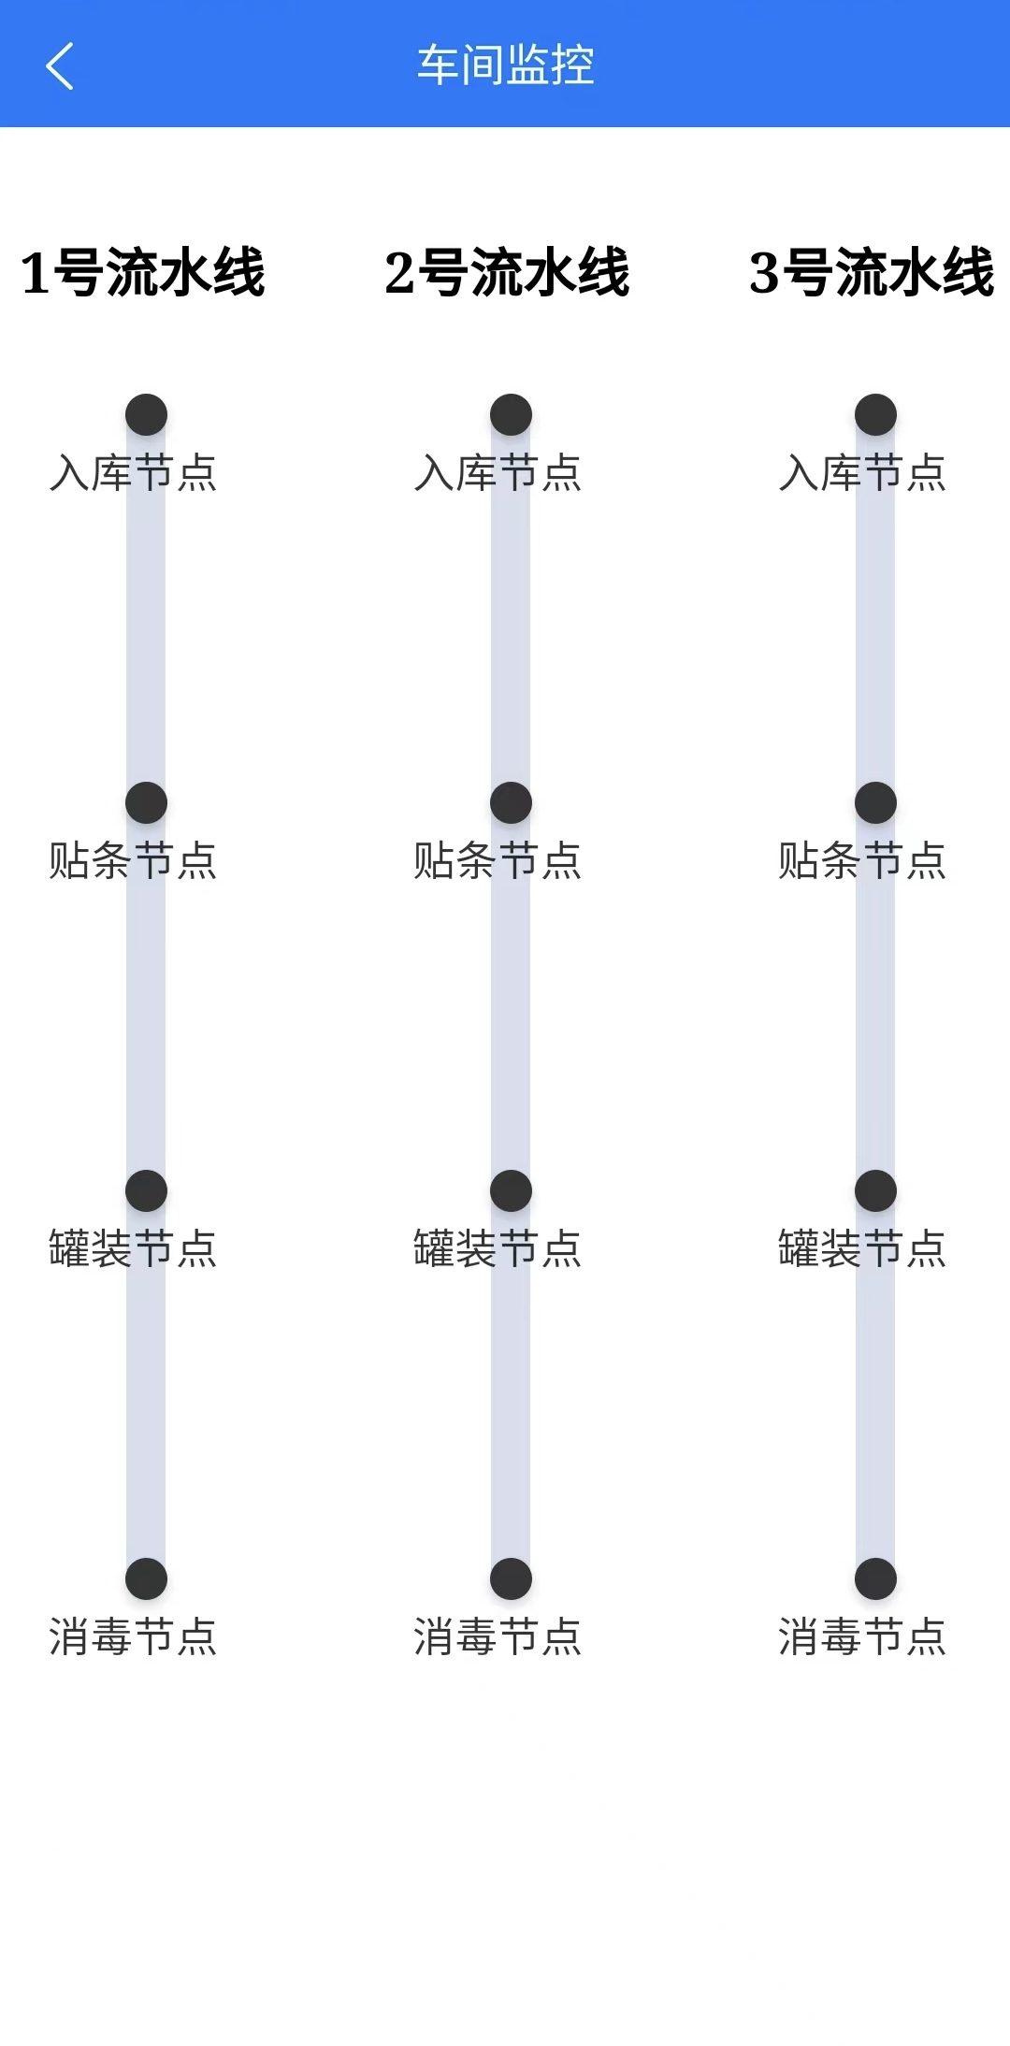
We can monitor all the information of production

Slide 9
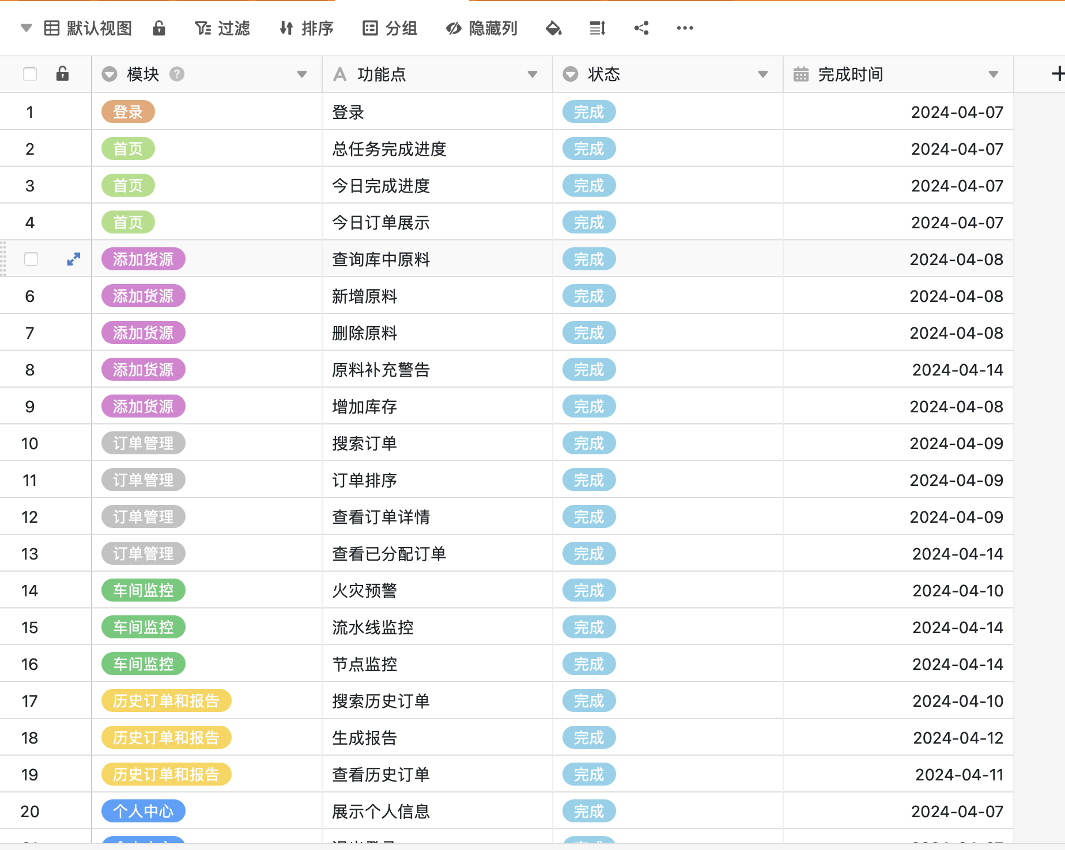
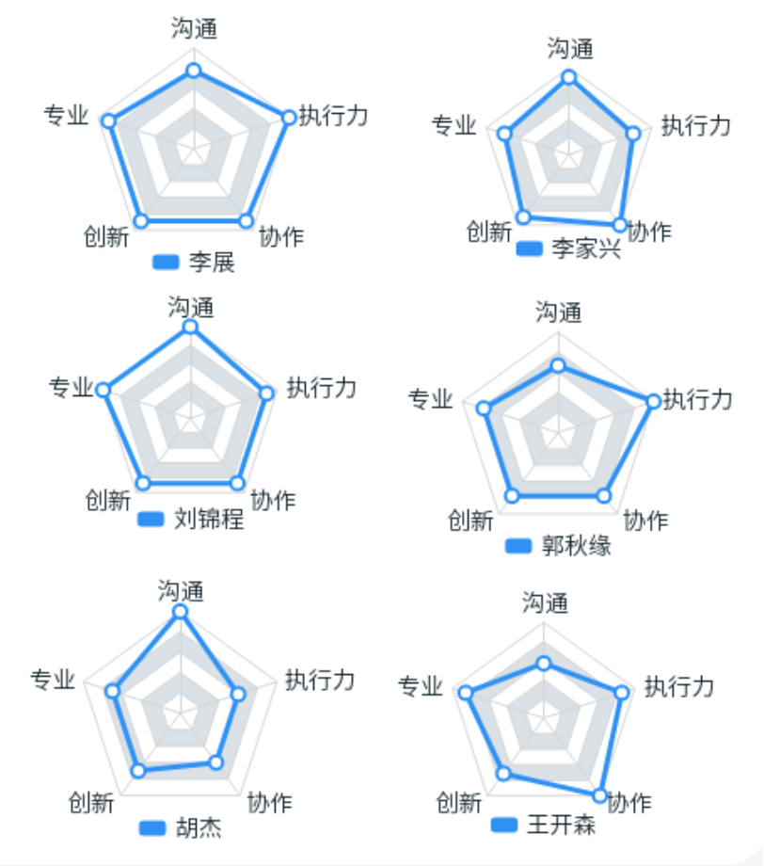
Project Overview

Slide 10
Backend
Li Zhan

Slide 11
Contribution
Deliverable
Material management
Warehouse monitoring (MQTT)
Algorithm development
Real-time product quality monitoring using YOLO algorithm
Real-time scheduling and allocation of pipeline orders based on the expansion of the Highest Response Ratio Next（HRRN) algorithm
Material amount inference using Triple Exponential Smoothing algorithm

Slide 12
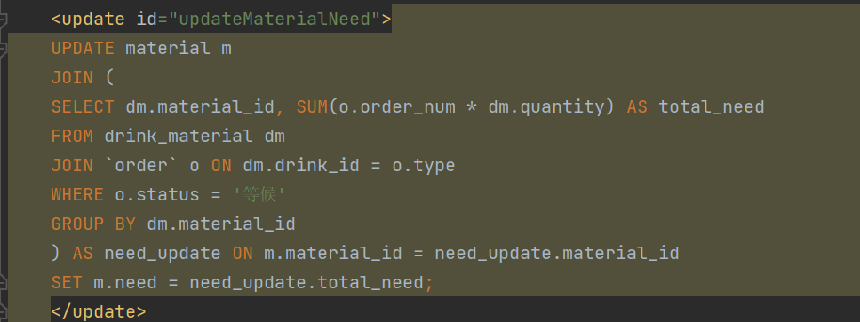
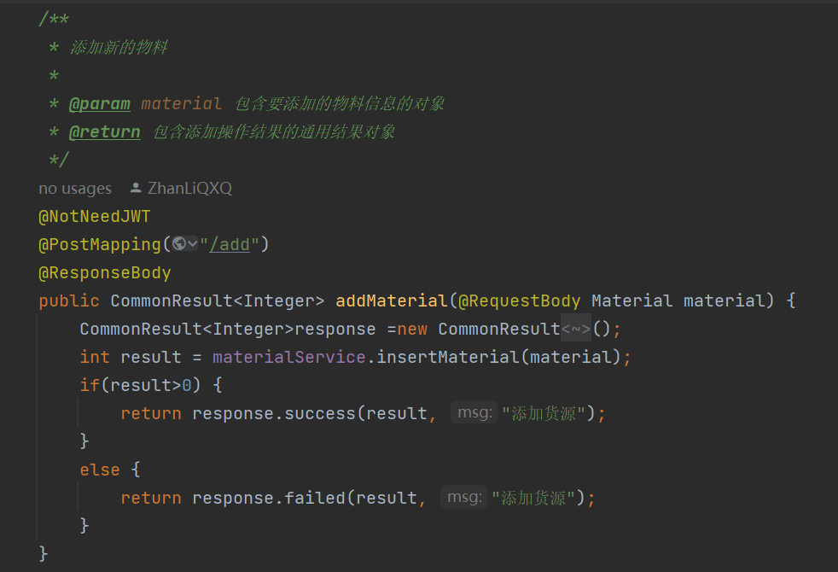
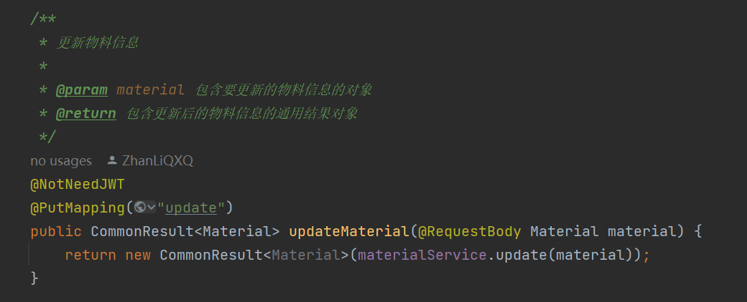
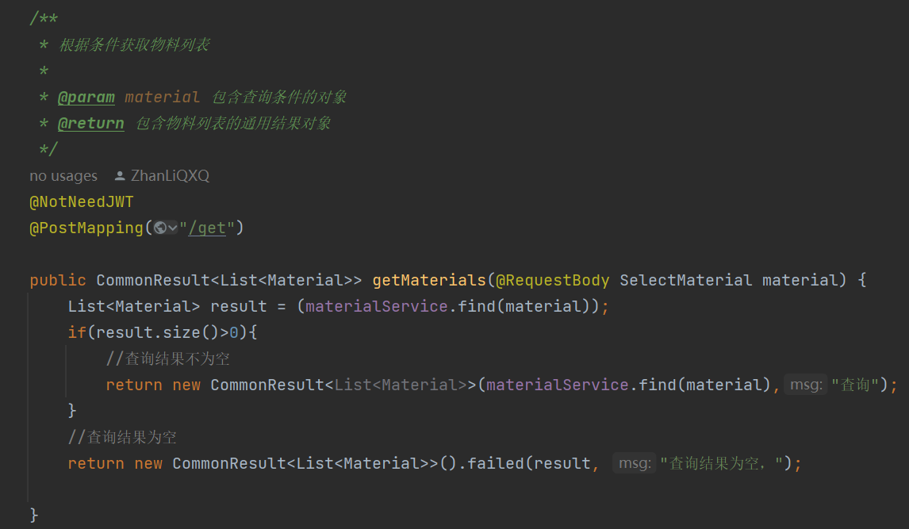
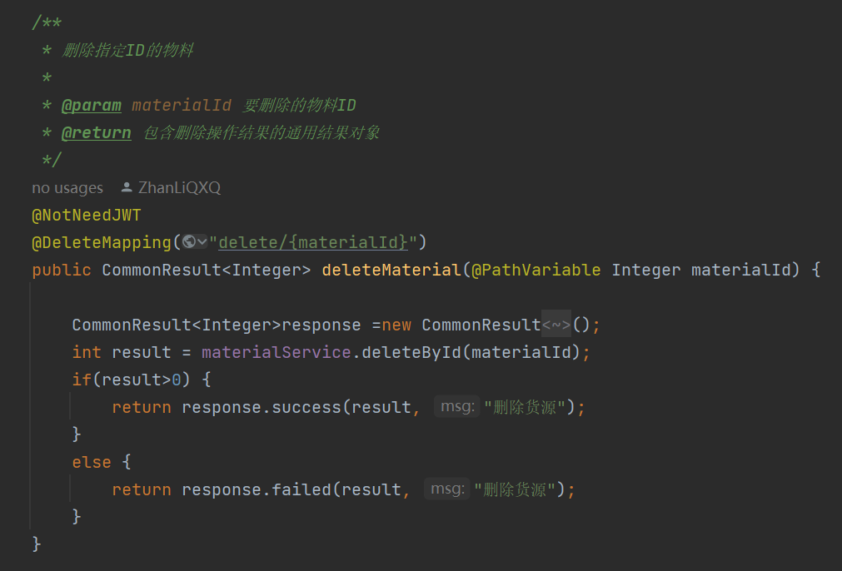
1. Material management
Deliverable
Auto- calculating and updating the required raw material quantities based on real-time order data
Creation, retrieval, updating, and deletion (CURD) api

Slide 13
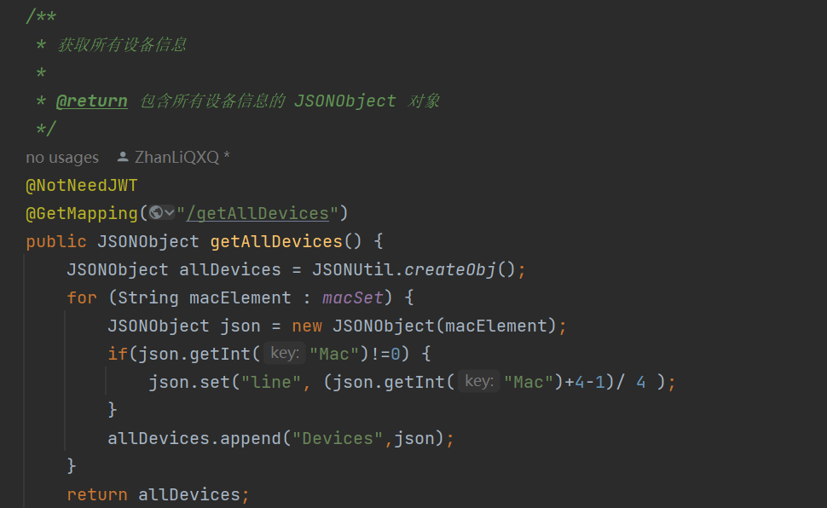
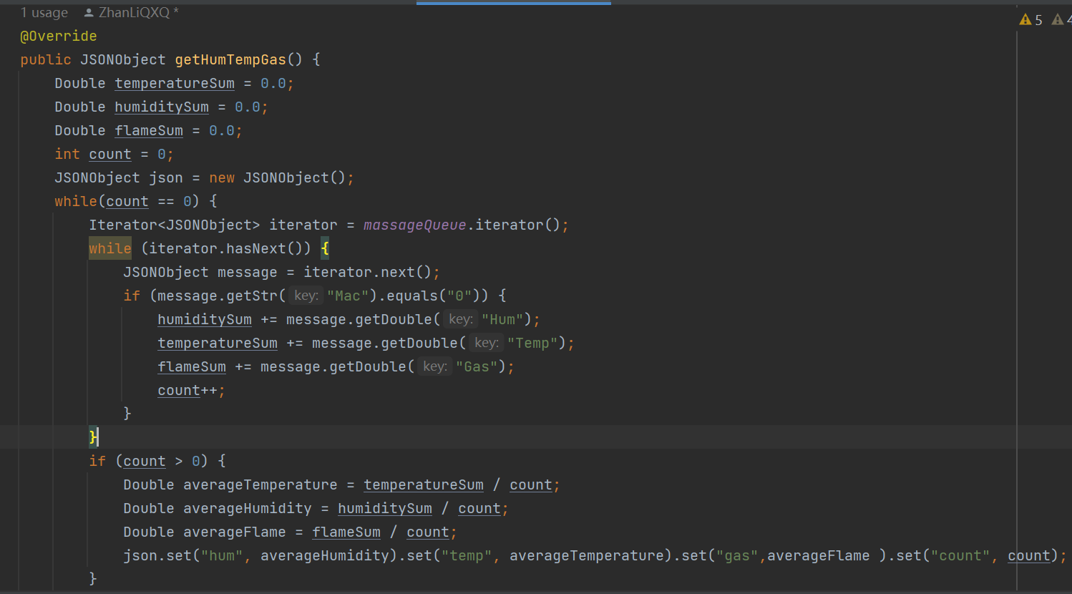
2. Warehouse monitoring (MQTT)
Deliverable
Adaptable Connection Protocol to hardware
Implemented real-time communication via MQTT
temperature, humidity, gas, water level, fire alarms
quantity passed NFC nodes & disinfection nodes

Slide 14
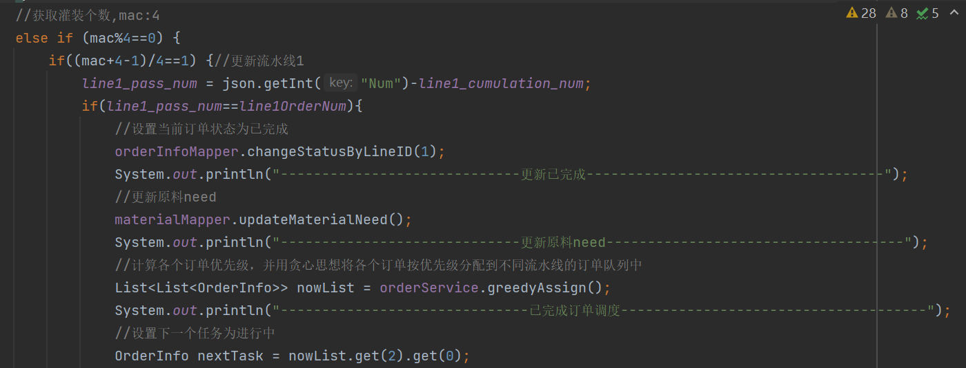
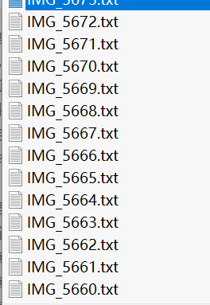
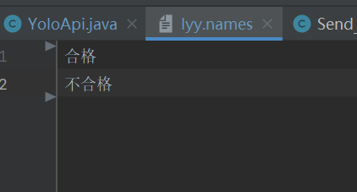
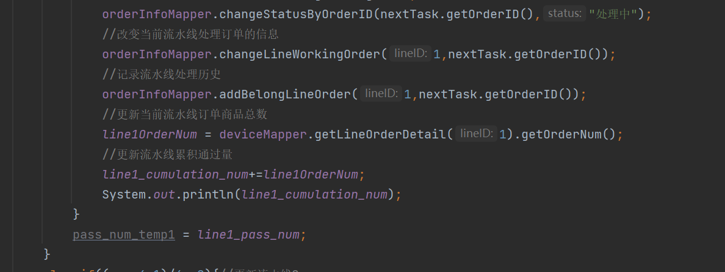
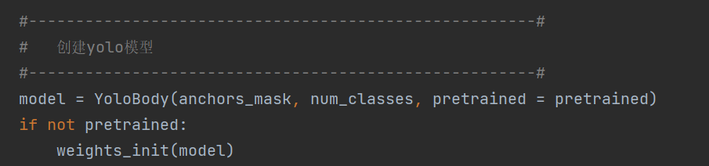
Quality Monitoring (YOLO)
Deliverable
Algorithm 1
implementing the YOLO algorithm to monitor the quality of produced items in real-time on workshop production lines

Slide 15
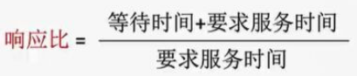
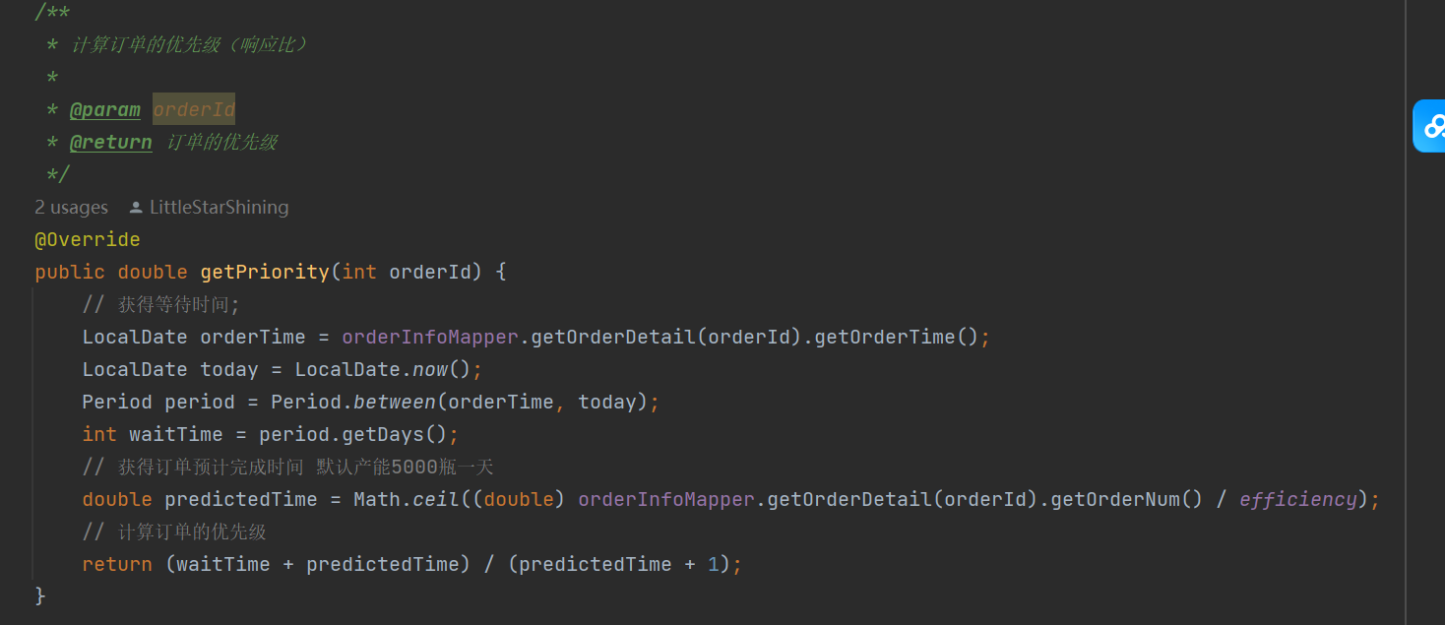
Highest Response Ratio Next（HRRN)
Deliverable
Algorithm 2
Real-time scheduling and allocation of pipeline orders
Calculated order priorities based on quantity & deadline

Slide 16
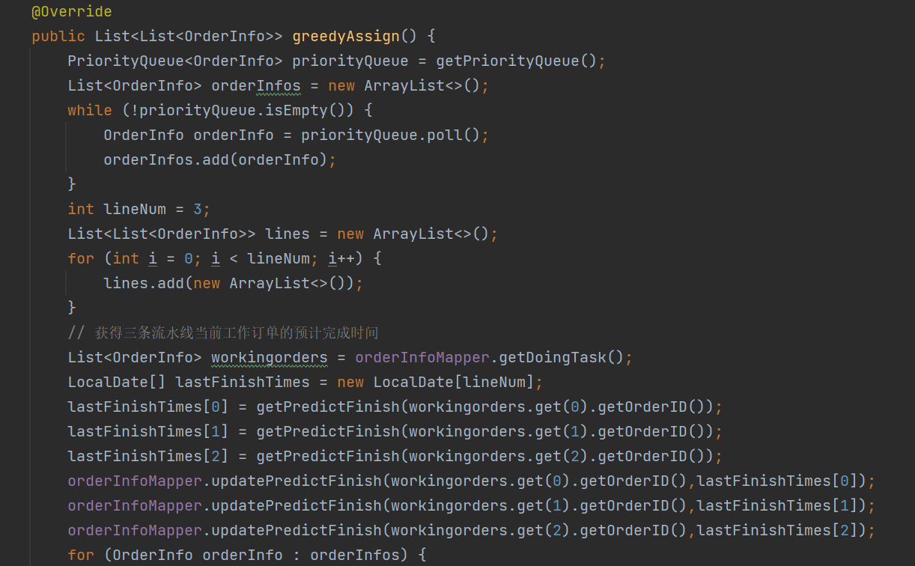
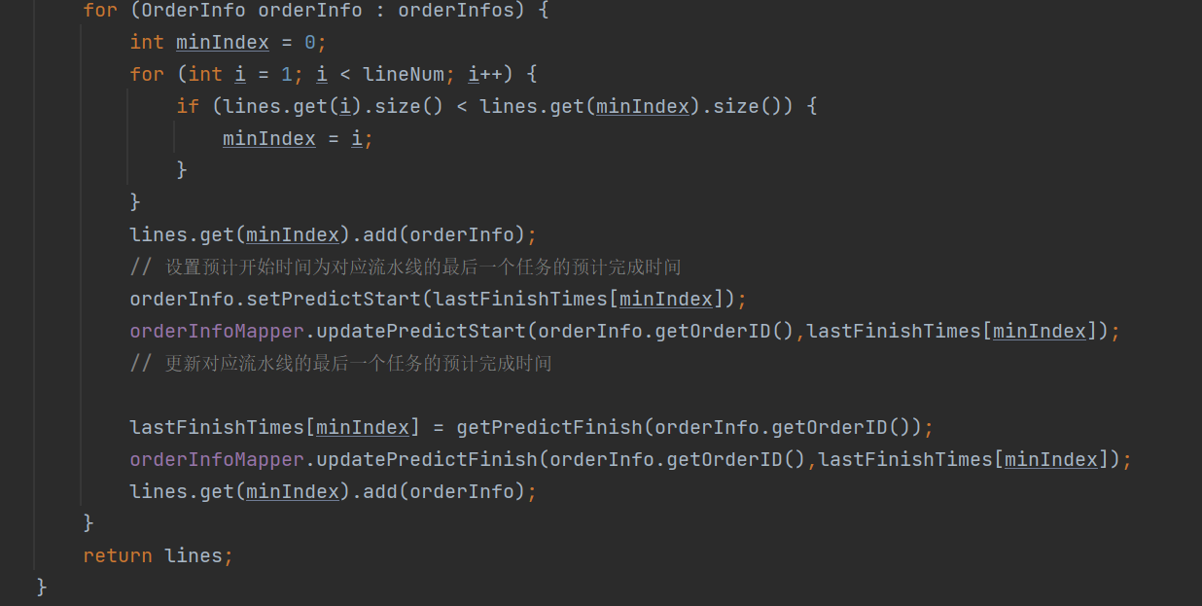
Greedy Algorithm to automatically assign the highest priority orders to respective production lines

Slide 17
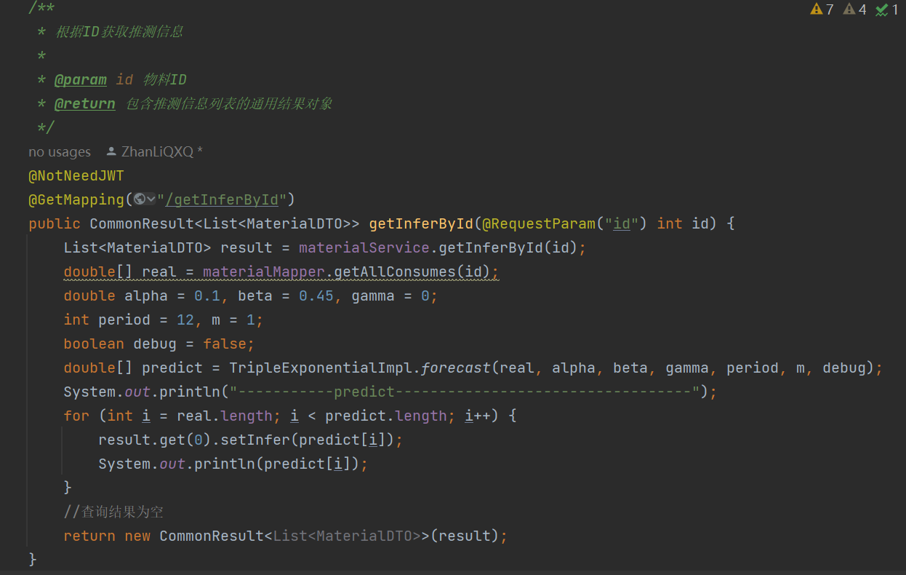
Estimated raw materials consumption
Deliverable
Algorithm 3
Material consumption inference using Triple Exponential Smoothing algorithm
Ensure that raw material supply matches production demand

Slide 18
Backend
Li JiaXinG

Slide 19



technologies, software
Technology/software
Tech stack
Java1.8 + Spring Boot + Mybatis （SM）
MQTT
WebSocket
SQL
Maven
Git
Subject basis
data structure
network
operating system
New tech in SE
Enterprise-grade development framework
Software
IDEA
Apifox
MySQL
GitHub

Slide 20
Deliverables
Specific contributions
Database design
Order management module
User module
Data dashboard module
Scheduling and forecasting algorithms

Slide 21
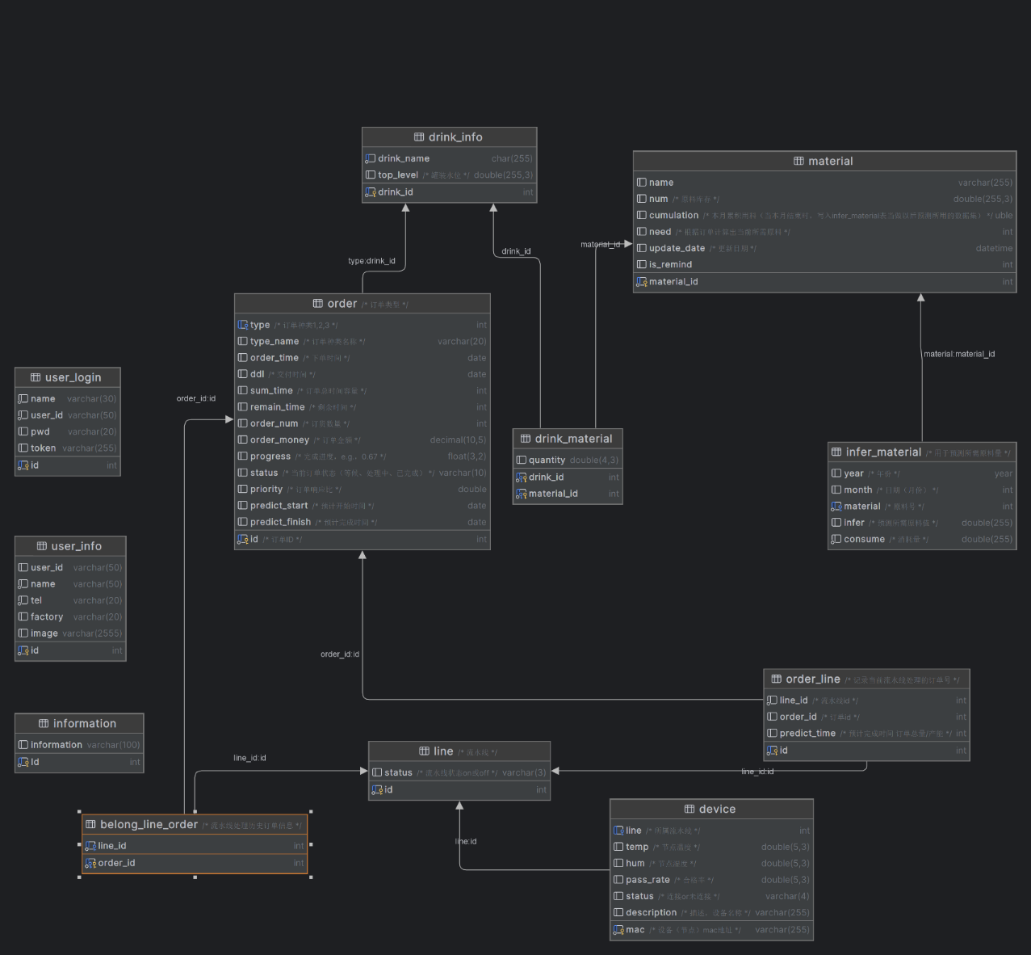
Evidence
Database design
Fields and constraints
Relationship
E-R diagram

Slide 22
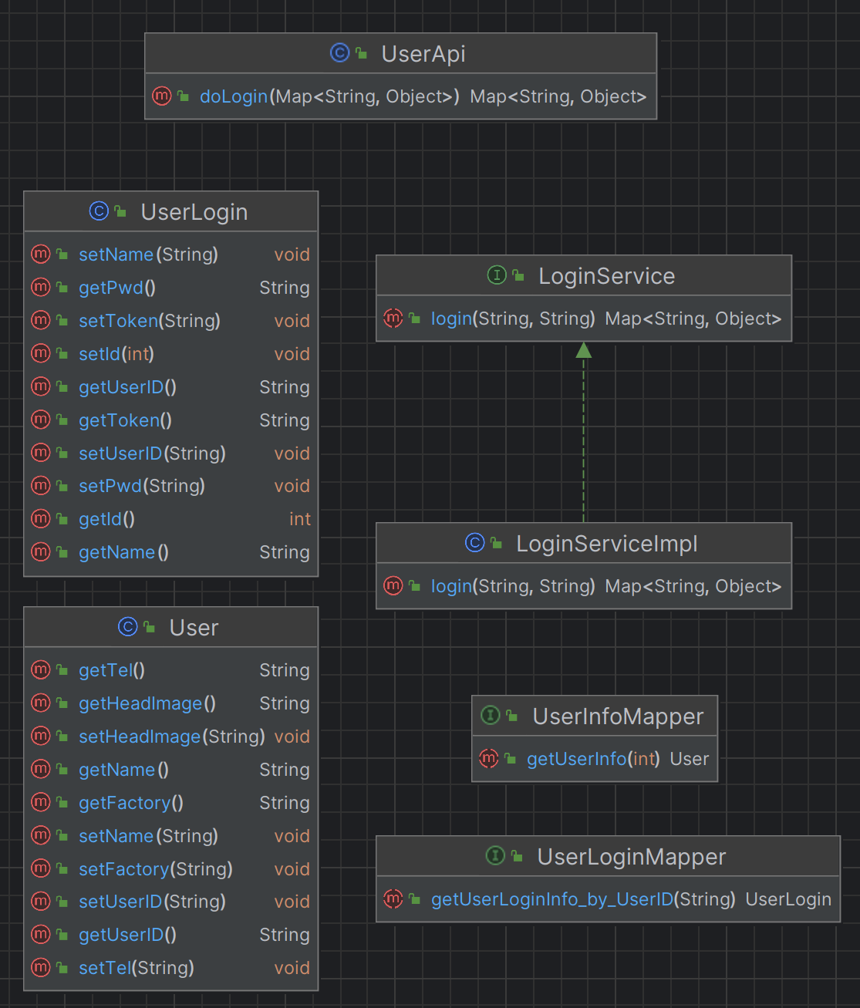
Evidence
User module
1. User login and registration
2. User information management

Slide 23
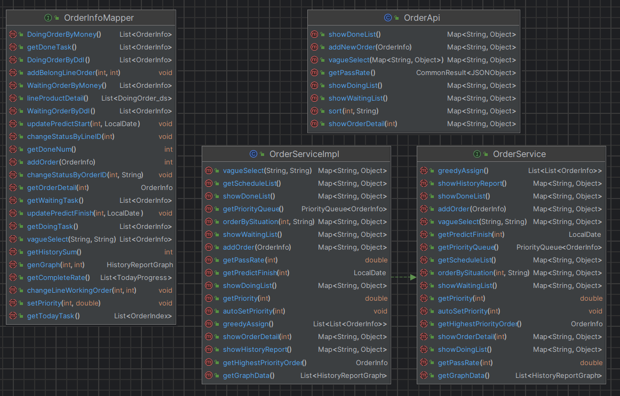
Evidence
Order management module
1. Order scheduling
2. Order Inquiries
3. Monitor orders

Slide 24
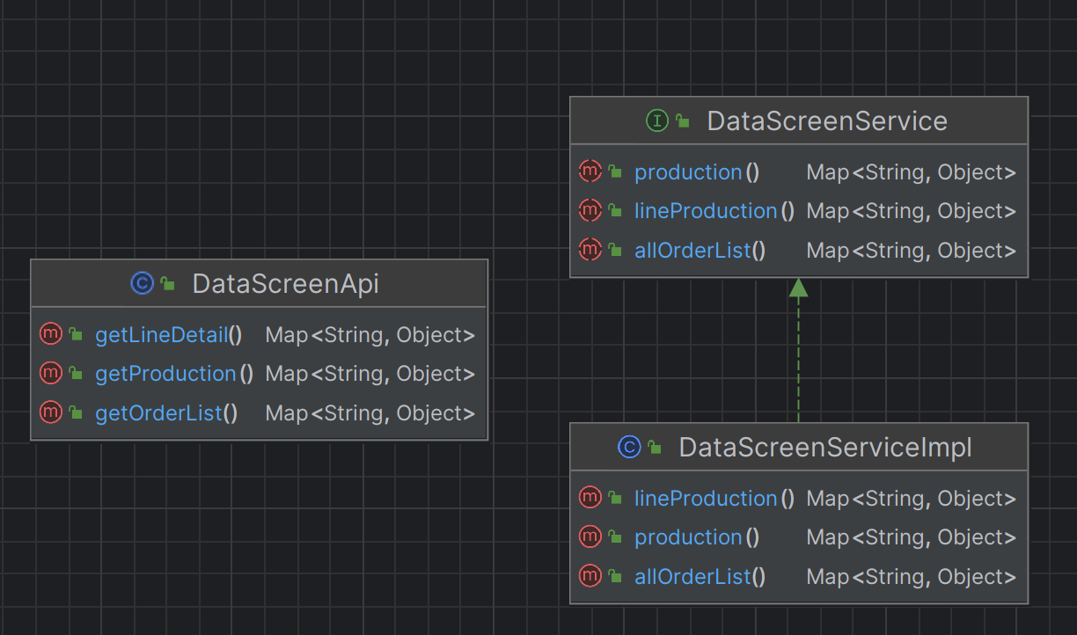
Evidence
The interface and implementation of the content to be presented by the data screen
Data dashboard module

Slide 25
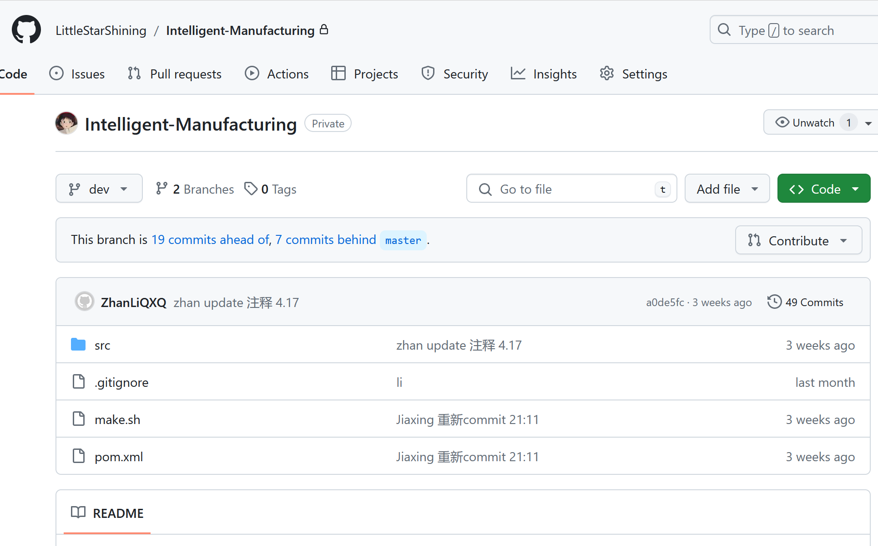
Evidence
Git management（GitHub repository）

Slide 26
Reflection/Lessons learned
Challenges
The lack of design experience leads to a low rate of code reuse
The business logic is complex and the system is huge
Reflections
Introduce best practice design patterns to refactor the system
Streamline the system, retain and develop the modules that we are good at

Slide 27
Frontend
Liu jincheng

Slide 28
Deliverables
Specific contributions
Personal Homepage and Contact Page
workbench Page
Supply Management System
Production Line Monitoring Page
Data Dashboard
Notes:
Today I am thrilled to share my recent internship(intenship) experience.
During this internship, I worked on front-end development using Hbuilder based on Vue2, and Uview. We designed and developed a factory management app and I was mainly responsible for Personal Homepage and Contact Page、Workbench Page 、Supply Management System、Production Line Monitoring Page and A data Dashboard.

Slide 29
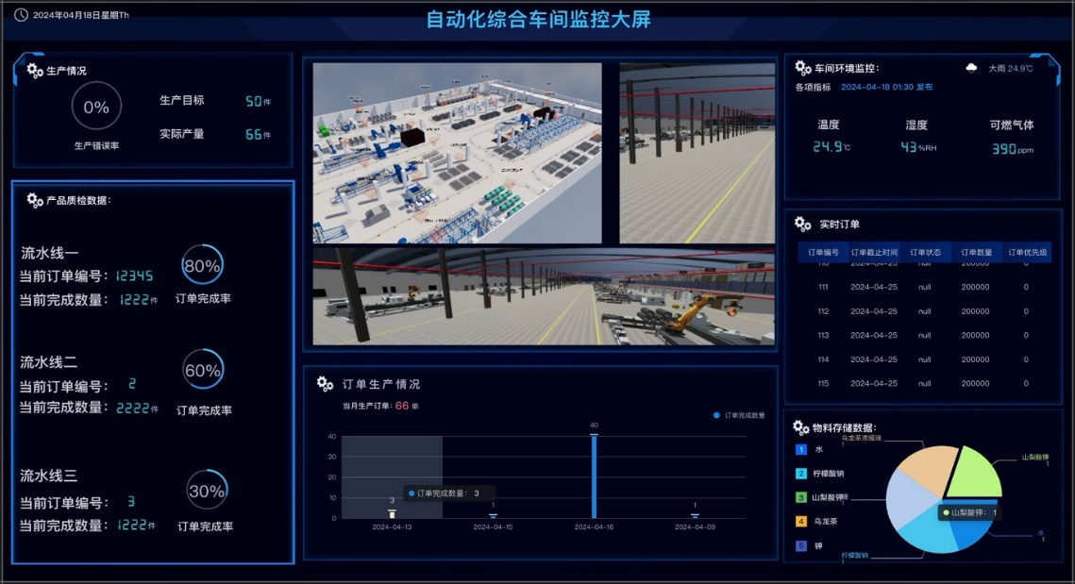
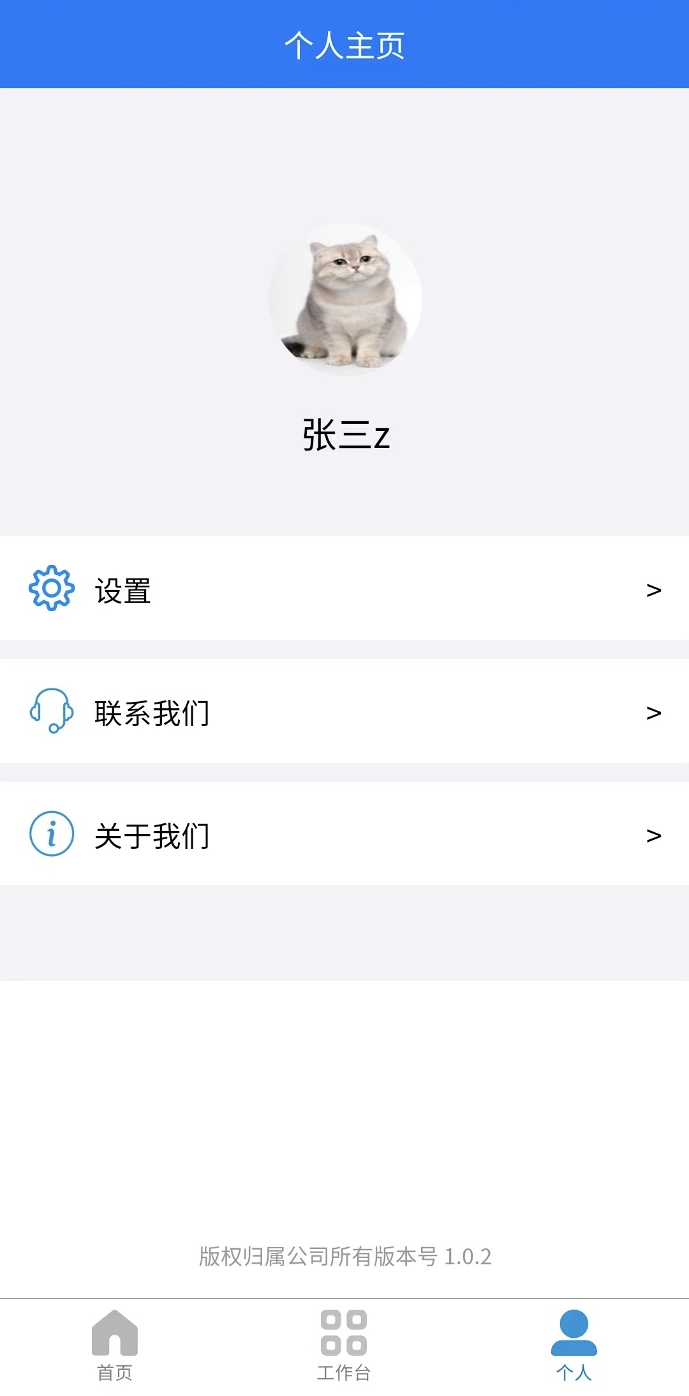
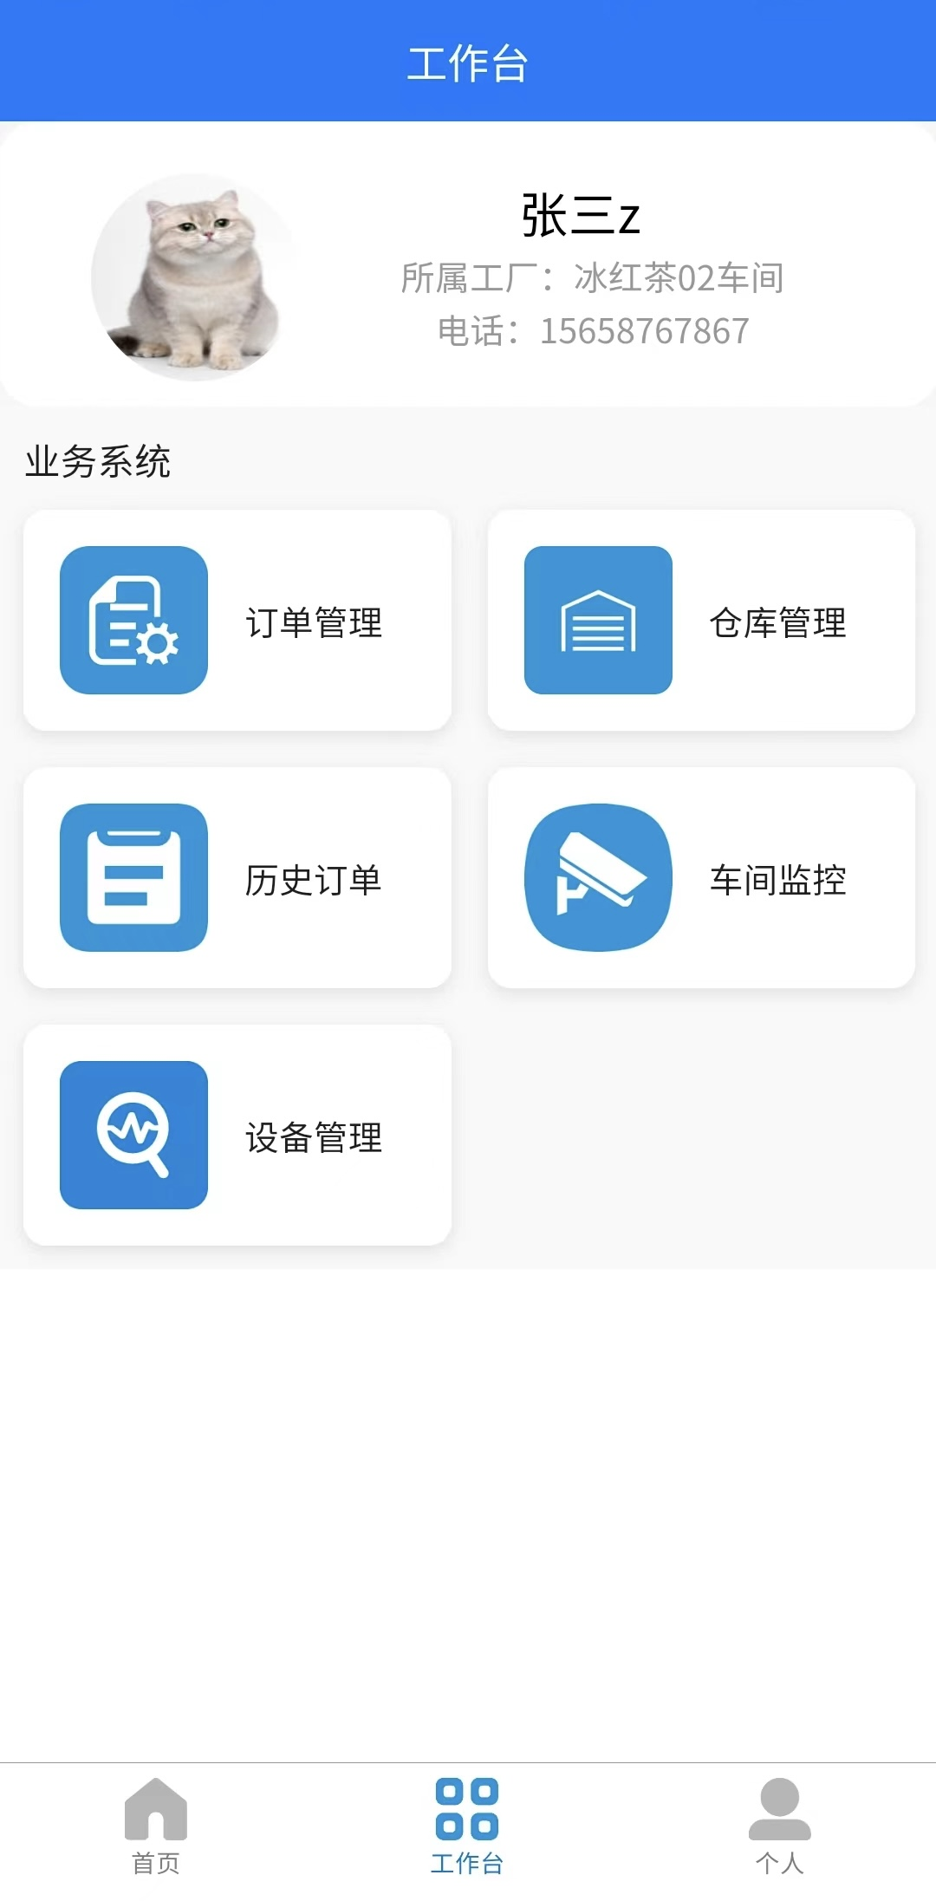
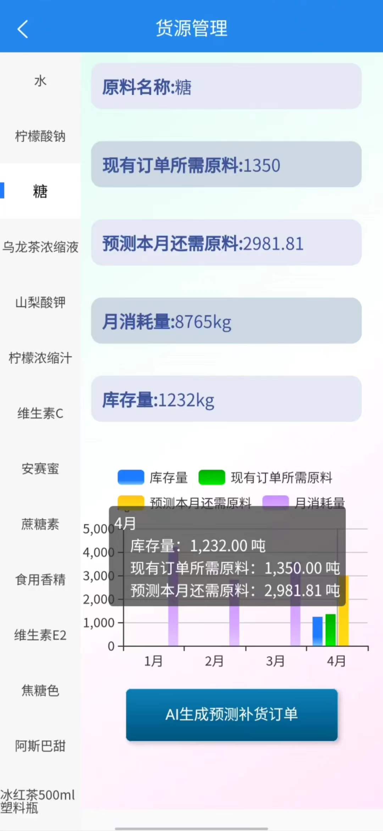
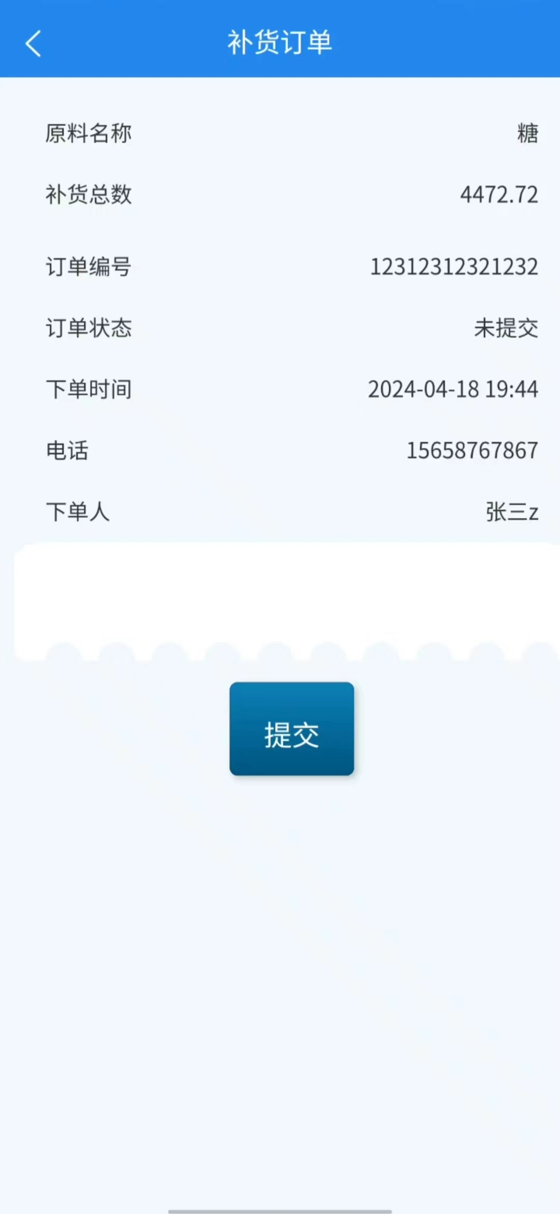

Evidence
Notes:
Key pages I worked on as follow:
Personal Homepage and Contact Page: it includes personal info, contact support, and learn about the app.
Workbench Page: The clear interface and navigation make it easy for users to switch between modules, greatly improving efficiency and satisfaction.
Supply Management System: In this part, You can Monitor raw materials, predict needs, and track consumption.
Production Line Monitoring Page: it reveals Real-time status of production lines.
In fact, I built an RTMP server based on the RTMP protocol and used the camera of my phone as a surveillance(servlens) device to achieve real-time monitoring of the factory
And If the temperature measured is higher than the threshold, it will navigate to Alert Page
Data Dashboard: it visualize key metrics like production status.

Slide 30
Reflection/Lessons learned
Challenges
changing requirements,
technical constraints
time pressure.
Reflections
improve requirements analysis
technical skills
testing processes
user feedback
Notes:
I also meet a lot of challenges such as changing requirements, technical constraints, and time pressure. Through teamwork and continuous improvement, we delivered a high-quality project. The system is user-friendly and efficient.
Due to the internship I learned the importance of understanding user needs and focusing on user experience. In future projects, I will aim to improve requirements analysis, technical skills, testing processes, and user feedback.
There are all together
Thank you for listening.

Slide 31
Frontend
Guo qiuyuan

Slide 32


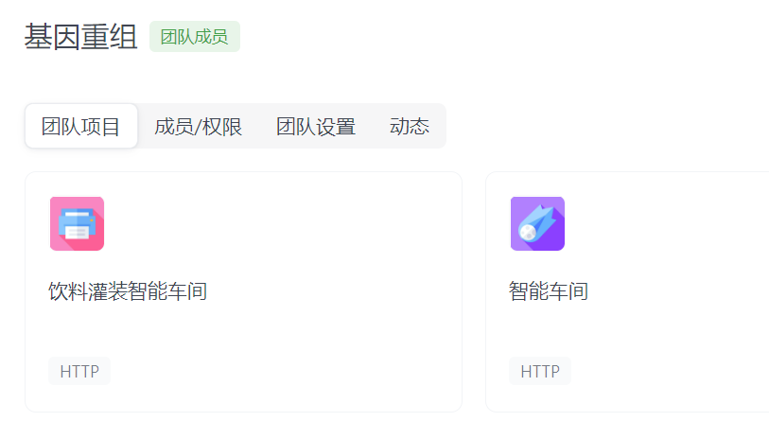
Methods, technologies, software
Web Development Technologies
Frontend Design and User Experience
Frontend Data Management
Cross-Platform and Cross-Browser Compatibility
Performance Optimization and Testing
Notes:
During the development process, I work as a front-end engineer. frontend engineers require a comprehensive understanding and proficiency in a range of technologies and practices. This includes mastery of web development technologies. I must also be adept in frontend design and user experience principles to create appealing interfaces. Additionally, proficiency in frontend data management techniques is crucial,too. Ensuring cross-platform and cross-browser compatibility is essential to guarantee a friendly user experience. Finally, frontend engineers must focus on performance optimization and testing to enhance application loading speed and overall performance. We mainly use uni-app's mobile framework template and APIfox tool for data interaction.

Slide 33

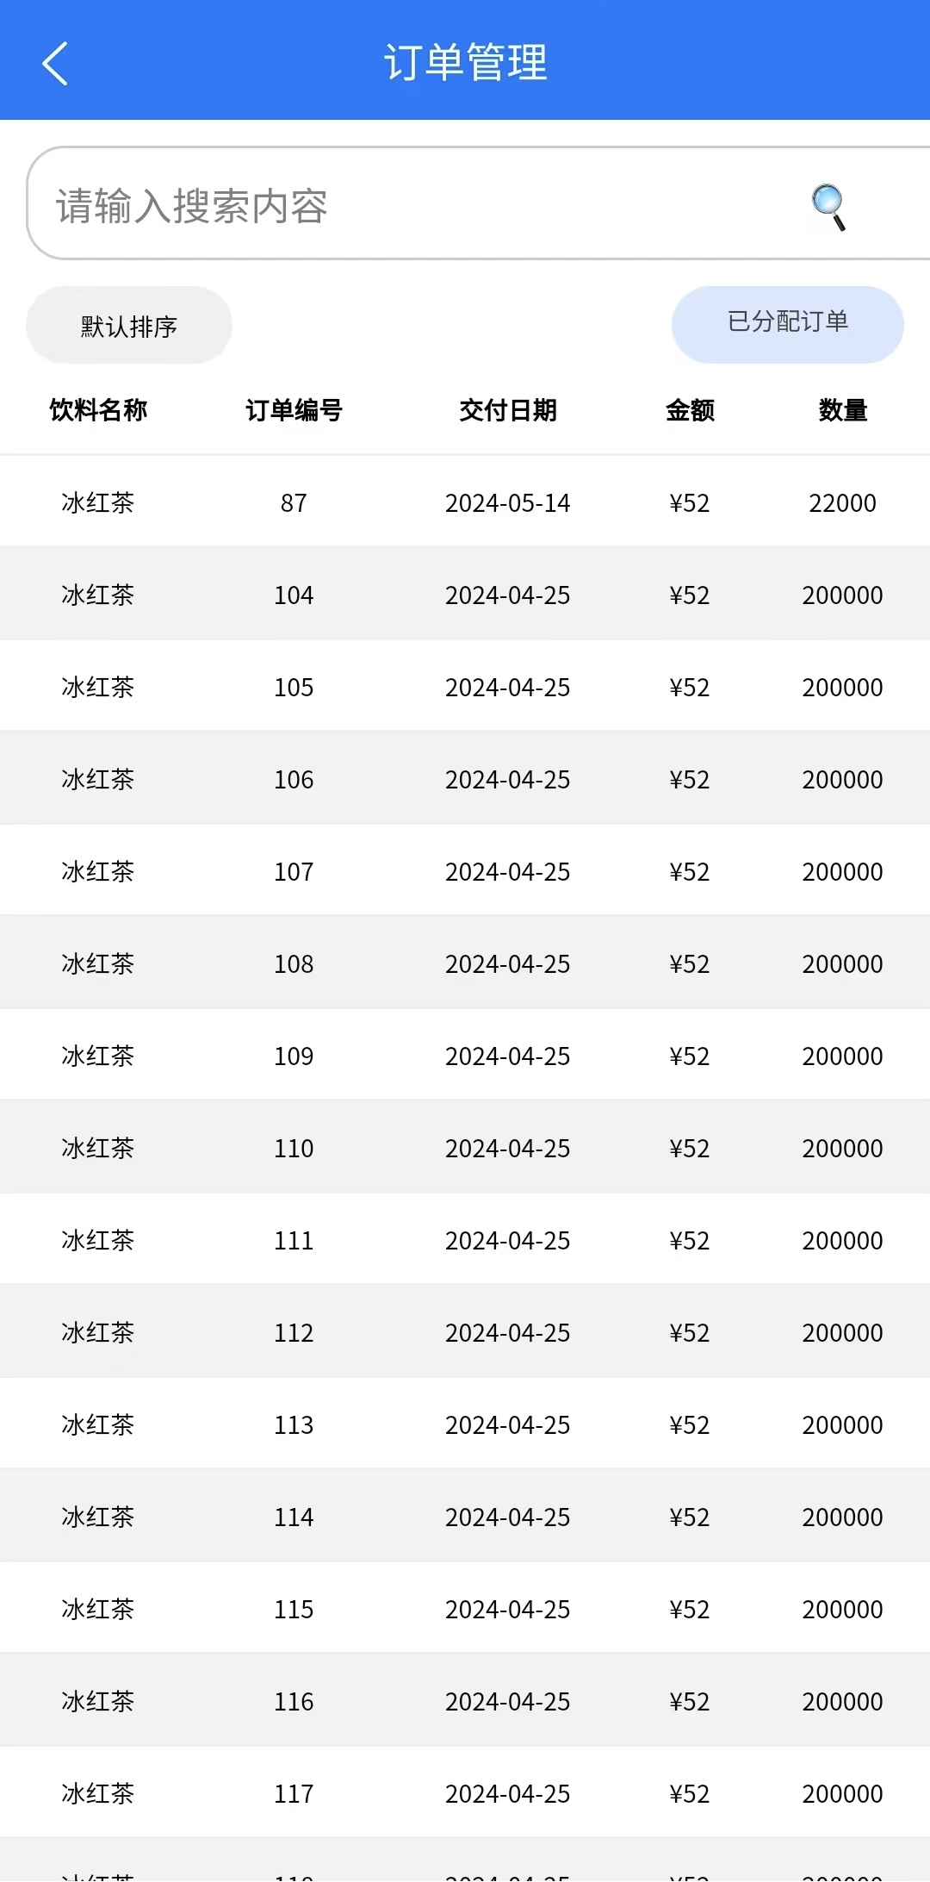

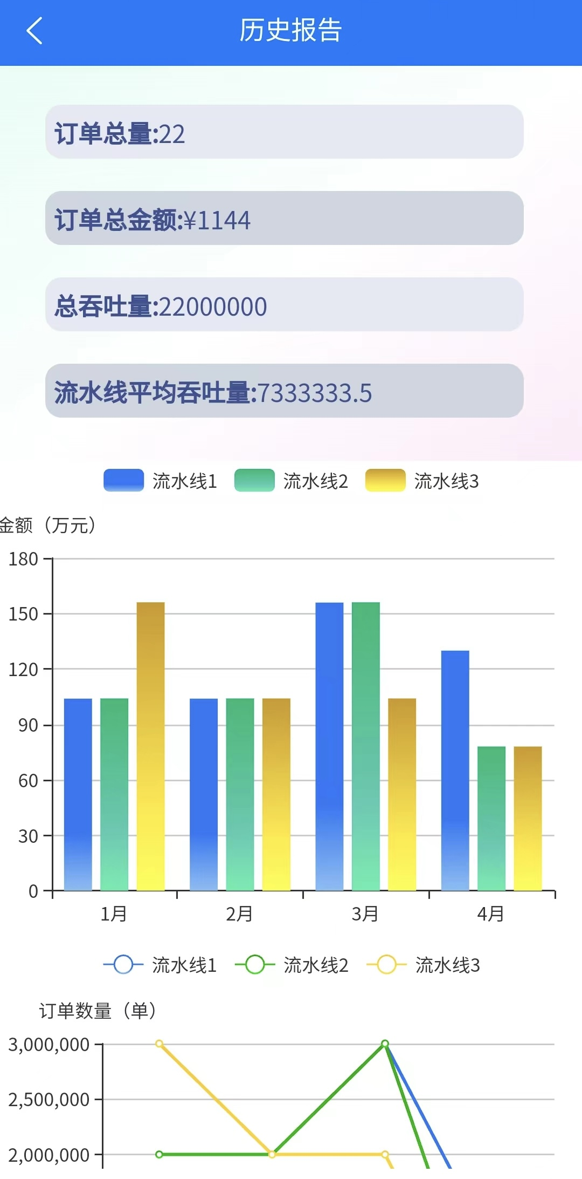
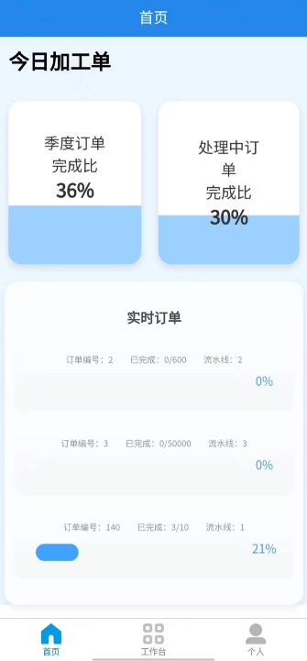

Deliverables
Specific contributions
Raw material management page
order management page
Device management page
order history page
home page
login page
Evidence
Notes:
I was mainly responsible for the design of the following four functional pages: Raw material management page, order management page, Device management page and order history page. In addition, the home page and login page are also my main implementation. On the right are some screenshots of the app we developed

Slide 34
Reflection/Lessons learned
Challenges
Efficiency of front - and back-end interactions
The upgrading of technology
Communication and cooperation with team
Reflections
Technical proficiency
Page continuity and aesthetics
User experience
Code standardization
Notes:
In navigating the challenges of web development, We encounter various hurdles, including optimizing the efficiency of interactions between the front and back ends, staying abreast of technology upgrades, and fostering seamless communication and cooperation within our teams. Reflecting on my work, we emphasize the importance of maintaining high levels of technical proficiency, ensuring smooth page continuity and aesthetics, prioritizing user experience, and adhering to rigorous code standardization practices to uphold quality and consistency throughout the development process.

Slide 35
Hardware
Hu jie

Slide 36
Deliverables
Specific contributions
Hardware node design and writing
- Environment node
- Disinfect node
- Filling node
- Detect qualified nodes
- Inbound node
Transport protocol design
Evidence
Notes:
The project involved the design of ten hardware devices and six nodes. As a hardware engineer, I develop on the HarmonyOS platform, select appropriate hardware devices, write effective drivers, and design stable and reliable transmission protocols. The data is transmitted to the backend for processing through algorithms, and the monitoring interface is implemented for real-time monitoring. The project made extensive use of C programming language skills.

Slide 37
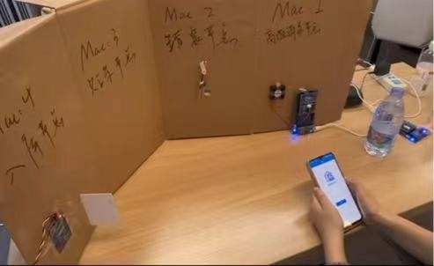
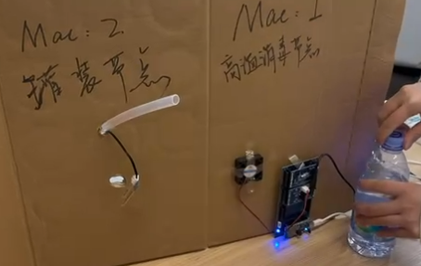
Evidence
Notes:
I took screenshots to show my contributions, including code snippets and design drawings.

Slide 38
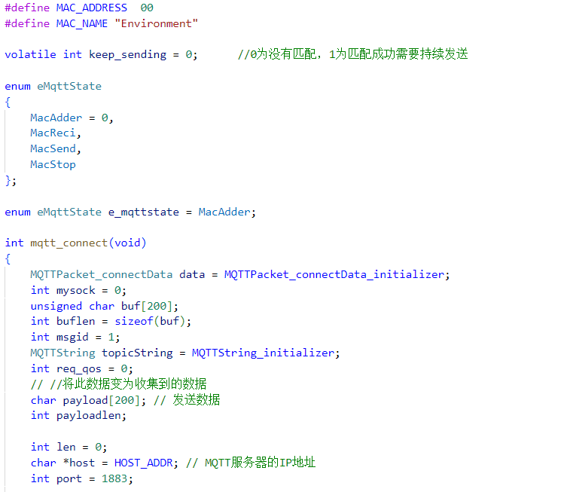
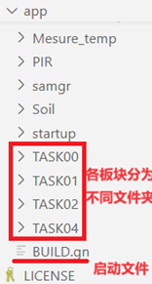
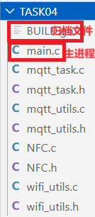
evidence

Slide 39
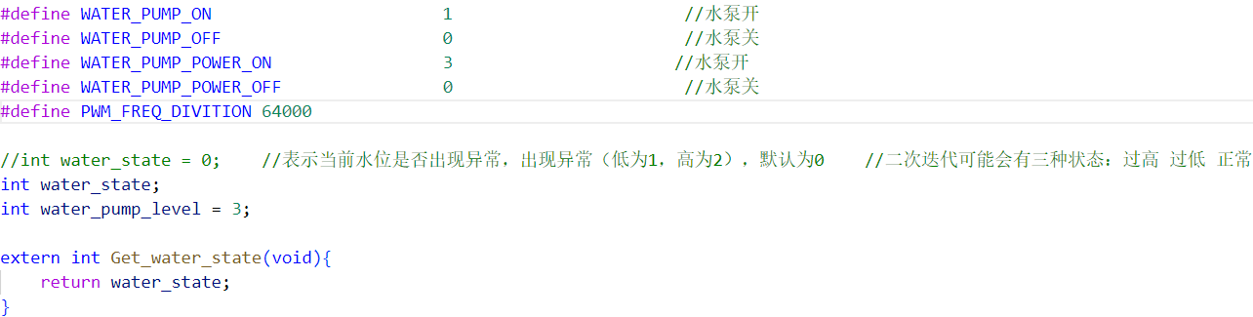
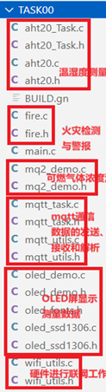
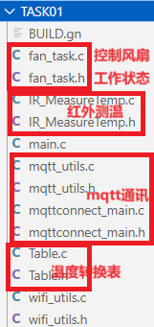




evidence

Slide 40
Reflection/Lessons learned
Challenges
Transmission Protocol Design
Hardware Node Debugging
Reflections
optimize the hardware
Enhancing the system's smart features
Notes:
Designing a transmission protocol for compatibility with multiple hardware modules is complex, requiring accurate data transmission and system stability.
During hardware node debugging, meticulous logic is essential. Issues like sensor connection abnormalities occurred, but were resolved through various software tests, ensuring normal node operation.
Going forward, hardware needs to be optimized to make it smarter and tightly integrated with real factory manufacturing processes. Enhancing the smart capabilities of the system will be a focus area to improve overall functionality and efficiency.

Slide 41
AQ
As a big group with 6 students, how did you allocate the tasks for each of the student? Did you assign the work on your own or have someone allocate for the whole group? Which tool did you use to achieve the cooperation?
We assigned the tasks by ourselves. We used seatable, a tool or app like excel and table graphs, to allocate each group member’s task. When finishing the task, each student will write down what he have done onto the seatable.
As a big team, how did you achieve the efficient cooperation with each other?
For the backend, we used github to cooperate with each other and manage the iteration of the project. In addition, we had written the api document using apifox to improve the efficiency of standard data transmission between the frontend and the backend.
Notes:
Designing a transmission protocol for compatibility with multiple hardware modules is complex, requiring accurate data transmission and system stability.
During hardware node debugging, meticulous logic is essential. Issues like sensor connection abnormalities occurred, but were resolved through various software tests, ensuring normal node operation.
Going forward, hardware needs to be optimized to make it smarter and tightly integrated with real factory manufacturing processes. Enhancing the smart capabilities of the system will be a focus area to improve overall functionality and efficiency.

